Slide 1

Insights & Data AML caseManager
Case/Alert management tool for AML Solutions
February 2017

Slide 2

Problem statement
Major Banks needs a robust AML solution to avoid bigger aml sanctions fines
BNP PARIBAS paid almost $8.9 billion as penalties as it violated sanctions against Sudan,Cuba and Iran.
HSBC paid nearly $1.3 billion as it was accused of conducting transactions on behalf of customers in Cuba,Iran,Libya,Sudan and Burma.
ING was assessed with a $619 million penalty for allegedly moving billions of dollars on behalf of sanctioned Cuban and Iranian entities.
AML analysts are spending more than 70% of their time preparing and analyzing data, leaving no time for higher-order investigative work.
Many of the existing cases reports are in spreadsheets and manually lookup/copy is required.
Many of the major banks requires a case management system which automates the Data ingestion, Data transformation, Visualization using Big Data tools.

Slide 3
Why AML caseManager ?
It is designed to enhance the effectiveness of due diligence and AML investigation units.
It improves operational efficiency and AML/BSA compliance by taking advantage of new tools/technologies.
Taking advantage of Big Data and machine learning analytics, modern UI gives a quality and compliance improvements in AML program.
Lowering the average time-to-disposition reduces the cost of compliance.
Investigators requires interactive ,visually appealing user interfaces for case management.

Slide 4
Our Solution
Option1: COTS based approach
Stage1(Data Ingestion): Attunity tool, Kafka
Stage2(Data Transformation): HDFS,HiveQL, Pig & Shell scripts,Spark,Storm,HBASE
Stage3(Data Visualization): Attivio tool.
Option2: Open Source tools based approach
Stage1(Data Ingestion): Sqoop, Kafka
Stage2(Data Transformation): HDFS,HiveQL , Pig & Shell scripts,Spark,Storm
Stage3(Data Visualization): ELK (Elastic Search,Logstash & Kibana)

Slide 5

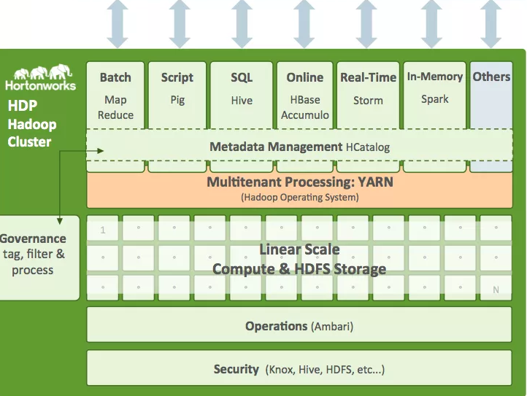
Flow Diagram(option1)
DATA SOURCES
Case Manager
AIE
Attivio Connectors
Cases / Alerts/Transactions/Customers ..
Attunity
Kafka
INGESTION
External Sources
Web Data
Spread sheets
(Watch list/KYC)

Slide 6
Flow Diagram(option2)
DATA SOURCES
Cases / Alerts/Transactions/Customers ..
INGESTION
Sqoop
Kafka
case Manager
HDFS/ Hive
Elastic Search
Kibana
External Sources
Web Data
Spread sheets
(Watch list/KYC)

Slide 7
Data Transformation – Map Reduce(Batch)
Cleanse the source data received in Hadoop as per the business rules.
Split the data into current and historical based on the timestamp for cases,alerts,transactions,customers and accounts.
Create the Counter party Risk Scoring(CPR) model for identifying the risk associated with each counterparties.
Identify the similar cases/alerts patterns for existing cases.
Create the address ,industry and other external info for each counterparty.
Automatically generate the case narrative at the end using the existing facts.

Slide 8
Resource Plan
Option1:
Stage1: 1 resource for 8 weeks. (tool understanding,Data setup, configurations,coding).
Stage2: 2 resource for 8 weeks. (Data transformation coding).
Stage3: 2 resources for 8 weeks. (tool understanding,UI Development, Server setup, coding).
Option2:
Stage1: 2 resource for 8 weeks. (Data setup, configurations,coding).
Stage2: 2 resource for 8 weeks. (Data transformation coding).
Stage3: 2 resources for 4 weeks. (tool understanding, Server setup, coding).

Slide 9
Domain & Technical Help
Resources working in stage1 needs to be beginner/intermediate level in Sqoop/Kafka.
Resources working in stage2 needs to be at least intermediate level in Hive,Pig,Shell scripting and at least some experience in Storm, Spark SQL,Spark ML and HBASE.
Resources working in stage3 needs to be at least beginner/intermediate level in ElasticSearch,Logstack & Kibana. Should have an understanding of Hadoop to Elastic search Integration.

Slide 10
Investment details (option 1)
Type of Investment | Resource Source | Cost Breakdown / Details | Total Loaded Cost
Development Lead Onshore | 1 FS SBU I&D Onshore | Solution Ownership 80 Hrs. | $5,000
Development Lead Off shore | 1 FS SBU I&D – Off shore Lead | Development, QA of Solution – 320 Hrs. | $6,000
Development Off shore | 2 FS SBU I&D - Offshore | Big Data Developers – 320 Hrs. | $11,000
Development Charges Off Shore | 1 FS SBU TDI - Offshore | UI Developer for attivio - 320 Hrs. | $6,000
Infrastructure | Application setup,misc expenses,software | New powerful machine required, Server setup | $3,000
3rd party tools | Attunity Replicate | License required for at least 2 machines | ?
3rd party tools | Attivio | License required for at least 2 machines | ?
Total |  |  | $31,000*

Slide 11
Investment details (option 2)
Type of Investment | Resource Source | Cost Breakdown / Details | Total Loaded Cost
Development Lead Onshore | 1 FS SBU I&D Onshore | Solution Ownership 80 Hrs. | $5,000
Development Lead Off shore | 1 FS SBU I&D – Off shore Lead | Development, QA of Solution – 320 Hrs. | $6,000
Development Off shore | 3 FS SBU I&D - Offshore | Big Data Developers – 320 Hrs. | $16,500
Development Charges Off Shore | 2 FS SBU TDI - Offshore | Kibana/Elastic Search Developer- 320 Hrs. | $10,000
Infrastructure Charges | Application setup,misc expenses,software | New powerful machine required, Server setup | $3,000
Total |  |  | $40,500

Slide 12
Appendix
Attunity Replicate – Data Ingestion tool. Supports many sources, change data capture(CDC) and Web UI options for data transfer
Sqoop – Data ingestion too. Used to data transfer between Hadoop and Relational database servers.
Attivio – Data Visualization tool for case management.
AIE – Attivio’s Active Intelligence Engine(AIE) transformation into actionable intelligence
Elastic Search – Distributed search engine.Data stored in index
Kibana – Visualization your Elasticsearch data.
Hive – It provides a SQL like interface.

Slide 13
Key AML terms
AML – Anti Money Laundering.
BSA – Bank Secrecy Act.
Counterparty – entity.
Transactions occur between 2 counterparties(entities).One will be originator of transaction and other is beneficiary.
Alerts have focal entity and consist of one or more transactions.
Cases are based on one ore more alerts.

